Slide 1


National Defence School,
University of Defence (UNID),
Neznanog Junaka 38, 11000 Belgrade
Classroom no. 4, National Defence School, University of Defence Wednesday, 7th March 2018
Knowledge FOr Resilient soCiEty
53942-EPP-1-RS-EPPKA2-CBHE-JP
Inter-project coaching meeting
Doc dr Mirjana Laban, University of Novi Sad
e-mail: k-force@uns.ac.rs
website: www.kforce.uns.ac.rs

Slide 2
The Project CV
Project Title | Knowledge FOr Resilient soCiEty
Project acronym | K-FORCE
Project Number | 573942-EPP-1-2016-1-RS-EPPKA2-CBHE-JP
Project Website | http://kforce.uns.ac.rs/
Project duration | 3 years
Start | 15th October 2016
Programme | ERASMUS+
Key Action | Cooperation for innovation and the exchange of good practices
Action | Capacity building in the field of higher education
Total cost of the project | 1.237.129,00 EUR
 |  | Grant for Project Activities: | 985.474,00 EUR
 |  | Additional Grant for Special Mobility Strand: | 251.655,00 EUR
Coordinator | University of Novi Sad

Slide 3
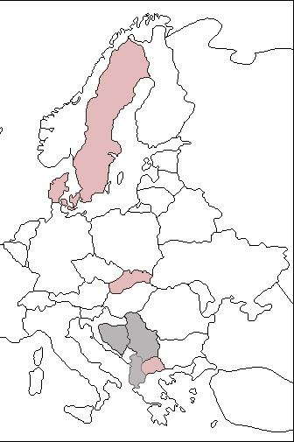
Consortium 14 + 2 associated partners
University of Novi Sad, Serbia
The Higher Education Technical School of Professional Studies, Serbia
The University of Tuzla, Bosnia and Herzegovina
The University of Banja Luka, Bosnia and Herzegovina
The University of Tirana, Albania
Epoka University , Albania
Technical University of Denmark, Denmark
Aalborg University, Denmark
The Lund University, Sweden
The University of Žilina, Slovakia
Ss. Cyril and Methodius University in Skopje, FYROM
Protection and Rescue Directorate of the Republic of Macedonia, FYROM
National Fire Protection Association – NUZOP, Serbia
European Youth Parliament Serbia – EYP, Serbia
Ministry of Security of Bosnia and Herzegovina, Protection and Rescue Sector, Sector for International Cooperation and European Integrations
Union of chambers of commerce and industry of Albania
AAL
DTU
LU
UNIZA
UBL
UNS
UNTZ
VTSNS
NUZOP
PRSBH
EYP
UKIM
UT
PRDM
EPOKA
UCCIA

Slide 4
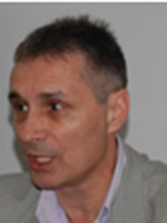
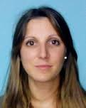
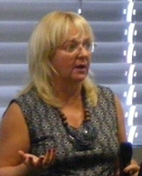
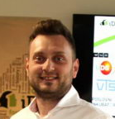
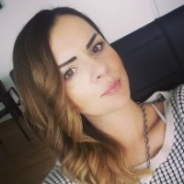
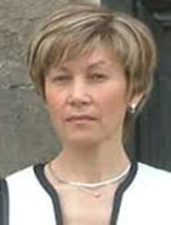
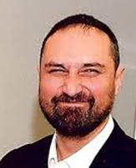
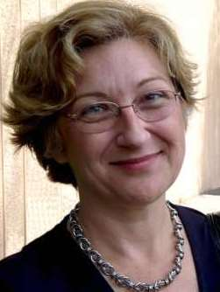
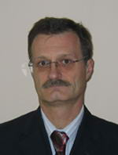
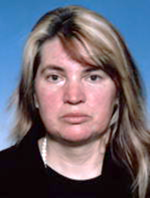
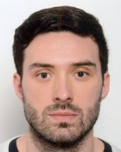
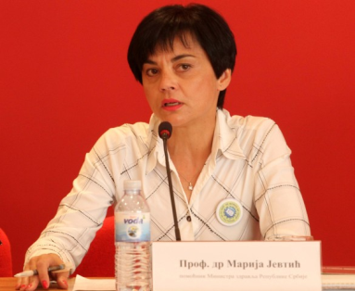
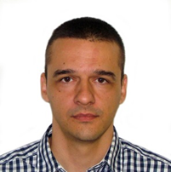
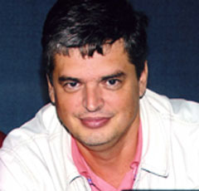
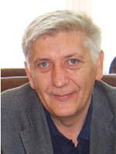
KNOWLEDGE FOR RESILIENT SOCIETY TEAM
PROJECT MANAGEMENT TEAM
k-force.pmt@uns.ac.rs
TEAM MEMBERS

Slide 5

Workplan
K-FORCE project is planned in three phases: preparation, development and implementation, and valorization phase, to be realized through 9 Work Packages (WPs):
WP1 Define directions for development of Master programs
WP2 Define directions for development of PhD programme
WP3 Improve teaching methodologies and embed the ICT in learning material
WP4 Implementation of Master Programmes
WP5 Implementation of PhD Programme
WP6 Implementation of LLL courses
WP7 Quality Assurance and Monitoring
WP8 Dissemination and Exploitation
WP9 Project Management
Contact name
email

Slide 6

In 3 years we plan to modernize/develop/implement 7 curricula at 6 WBC HEIs:
DRM&FSE academic master programmes/modules (UNS, UT, UBL, EPOKA),
DRM&FSE PhD programme (UNS),
Protection Engineering vocational master programme (VTSNS)
Economic and Financial Resilience vocational module (UT).
Study programmes will be interdisciplinary and created and implemented in a way that enables continuation of the studies for a number of different profiles of engineers.
The LLL courses implementation enables continuing education of DRM&FSE oriented professionals.
Study programmes, LLL courses and learning material will be available in EN/SR/BH/AL
Education material will be available in blended way (ICT learning platform, e-Library, DRM&FSE Glossary) as open source educational recourses.

Slide 7
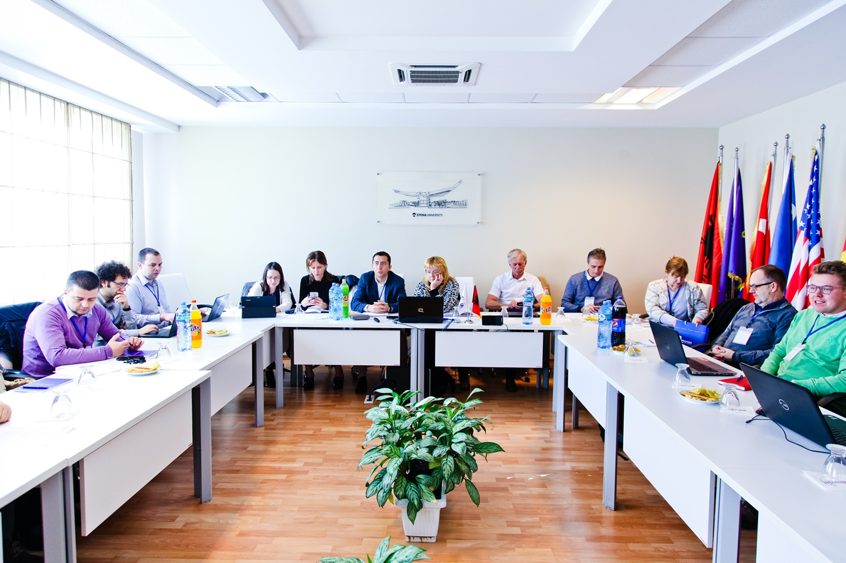
Meeting at EPOKA University, Albania

Slide 8
Special Mobility Strand - training
We have foreseen following SMS activities:
Students mobility between WB HEIs
Staff mobility from WB HEIs to Programme countries HEIs for the purpose of training
Staff mobility from project partner HEIs to WB HEIs for the purpose of teaching
Objectives of SMS activities are:
Contribution to the improvement of Master programmes, Modules and PhD programme implemented in WB HEIs
Creation of international learning experience for students at project partner HEIs,
Development of cultural awareness among students
Exchange of innovative teaching practices
Learning about teaching methods and practices from Programme countries HEIs
Development of complementary skills and competencies in the field of DRM&FSE
Promoting international understanding and cooperation

Slide 9
Special Mobility Strand - teaching

Slide 10
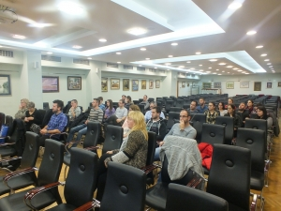
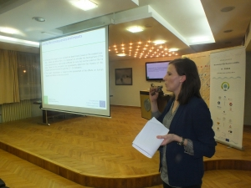
ENROLLED STUDENTS TO INNOVATED MASTER ACADEMIC STUDIES DISASTER RISK MANAGEMENT AND FIRE SAFETY
OPEN LECTURES IN WINTER SEMESTER 2017/2018
Webinar subtitled in
EN/AL/BiH/SRB
Ing. Katarína Hollá PhD,
Faculty of Security Engineering, University of Žilina

Slide 11
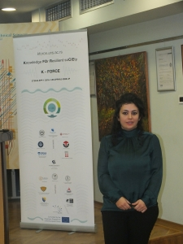

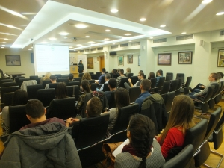
Julinda KEÇI, PhD, Lecturer,
Department of Civil Engineering,
EPOKA University

Slide 12
Special Mobility Strand - training

Slide 13


Date: 29-01-18
Place: Zilnia
Knowledge FOr Resilient soCiEty
SMS Training Visit to DTU
Technical University of Denmark (DTU)
Department of Civil Engineering (DTU-BYG)

Slide 14
TIME FRAME AND MAIN ACTIVITIES
1st week: Monday 12 March – Friday 16 March (WEEK 11)
Fire Lab: preparation of experiments for teaching activities
MSc Education: Fire Dynamics on Friday 16 March (8-12)
Pedagogical seminar and other seminar related to teaching
2nd week: Monday 19 March – Friday 23 March (WEEK 12)
MiB Education: 11B05 Fire Risk Management on Mon 19 and Tue 20 March
MiB Education: 11B27 Complex buildings on Thu 22 and Fri 23 March
MSc Education: Fire Dynamics on Friday 23 March
OBS: This is a tentative plan and can be subjected to changes

Slide 15
PRACTICAL ASPECTS
Theoretical background:
The project work and the teaching activities are focused on fire safety design. It is therefore desirable that you have a general background in this area.
In particular, it is good if you have some lab experience and interest either in fire risk or in fire safety design of complex buildings.
Please note that you will have plenty of time to study and prepare on your own or in small group before attending lectures and doing experiments.

Slide 16
PRACTICAL ASPECTS
Daily activity:
Daily activities include: attendance to seminars and lectures, preparation for lab project, participation in lab experiments, possible participation in teaching (to be agreed upon), as well as group-work and self study.
Daily activities will be organized within the time frame 8.00 to 16.00. On the days when there is no participation in courses, the activities will be limited to the time frame 9-15.
A social event will be organized (costs covered by yourself)

Slide 17
PRACTICAL ASPECTS
Travel and accommodation
Activities will start later on the first day and finish earlier on the last day, so that it is possible to arrive/leave on the same day
DTU Campus is in the commune of Lyngby, about 15 km from Copenhagen city center. It is well connected with bus 150S from Nørreport metro station in Copenhagen and with bus 190 from Lyngby train station (S-stog).
Unfortunately, DTU has no guest-houses or accommodations to offer. Finding an accommodation in Copenhagen is neither cheap or easy, so please start looking for one as soon as possible.

Slide 18

Knowledge FOr Resilient soCiEty
STUDY VISIT + TRAINING, UNIVERSITY OF ZILINE
January 29th to February 02nd, 2018
OFFERED LECTURERS
Ss. Cyril and Methodius University

Slide 19
Prof. Violeta Mirčevska
Methods and tools for Seismic Risk assessment and development of information system for emergency response and mitigation plans
Seismic hazard
Local site conditions (in each study area)
Detailed building inventory (in each study area)
Building classification scheme
Vulnerability models

Slide 20
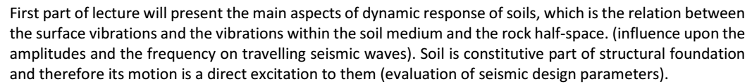
Prof. Vlatko Šešov
Earthquake Geotechnical Risks Manifestation, Consequences and Mitigation

Slide 21
Prof. Mihail Garevski
Basic knowledge to be prepared for earthquakes
Main characteristic and side effects of earthquakes
How to choose seismic sieve house/building
What to do before, during and after the earthquake

Slide 22
Prof. Meri Cvetkovska
Fire safety engineering-from theory to practice
Fire as accidental load on structures
Risks from fire as accidental load on structures
Behavior of concrete structures in fire
Behavior of still structures in fire
Behavior of wooden structures in fire

Slide 23
Assist. Prof. Marijana Lazarevska
PROJECT RISK MANAGEMENT
Definition of risk. Risks in investment projects. Classification and sources of risks. Characteristics and specificities of investment projects as possible sources of risk. Possible consequences of risks. Examples of risks.
Risk management and uncertainty management. Standards for risk management and their application in construction.
Stages of risk management. Planning risk management. Identification of risks. Qualitative risk analysis. Quantitative risk analysis. Methods for assessing the probability of occurrence of risk. Planning a risk response. Monitoring and risk control. Measures to reduce risks.

Slide 24
SECOND WEEK WORKSHOP
SAFIR AND OTHER PROGRAMMES FOR FIRE MODELING

Slide 25
Topics and staff
Topics:
Fire safety engineering – Fire modelling
Economics – Risks and resilience
Staff:
1 per year 2018 and 2019 from each institution = 6 per year
UNS, UNTZ, UBL, UT, VTNS, EPOKA
Activities:
Level assessment to adjust content
Introductory lecture(s) by UNIZA
Lectures for UNIZA students
Guided project work
Student scientific competition panel member
Final evaluation

Slide 26
JCSS Advanced Course on Systems Risk Modelling and Analysis in Engineering Decision Making
Decision Analysis, Probabilistic Systems Modeling, Probability Analysis, Risk Assessment - and Applications
Teachers
Prof. M. H. Faber, AAU, DK
Prof. J. D. Sørensen, AAU, DK
PhD. M. Schubert, Matrisk GmbH, CH
Prof. J. Nielsen, AAU, DK
Prof. J. Qin, AAU, DK
Prof. S. Miraglia, AAU, DK

Slide 27

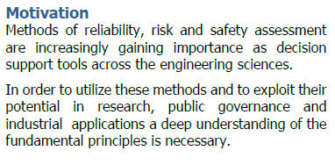
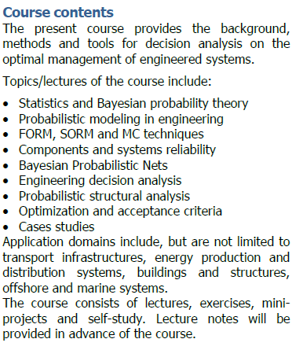
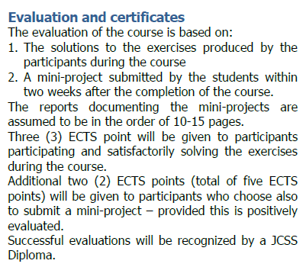

Slide 28
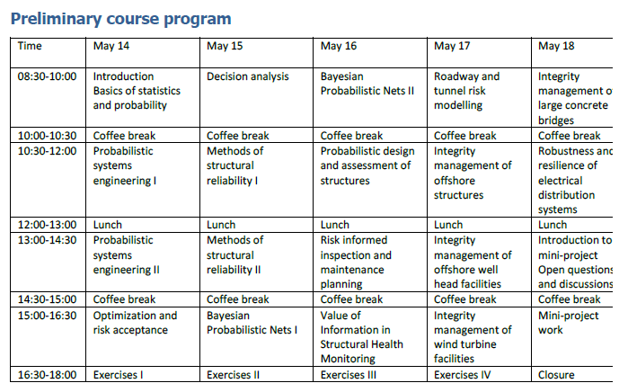


Slide 29
Special Mobility Strand Lund University
Enrico Ronchi
Lund University

Slide 30

SMS planning
2 Incoming groups in 2017/2018:
Group 1: Fire safety (evacuation)
(1 UNS+ 1 Epoka)
Training with Enrico Ronchi
(individual training on basics of evacuation + test with computer software Pathfinder)

Slide 31
SMS planning
Incoming: 2 groups in 2017/2018:
Group 2: Disaster Risk Management
(1 Uni Tirana + 1 UNS)
Training with Henrik Hassel + possibility to follow DRM courses in English → List:
Climate Smart Risk Reduction (January-March)
Risk Based Land Use Planning (January-March)
Preparedness and Planning (March-May/June)
Risk Assessment (March-May/June)

Slide 32
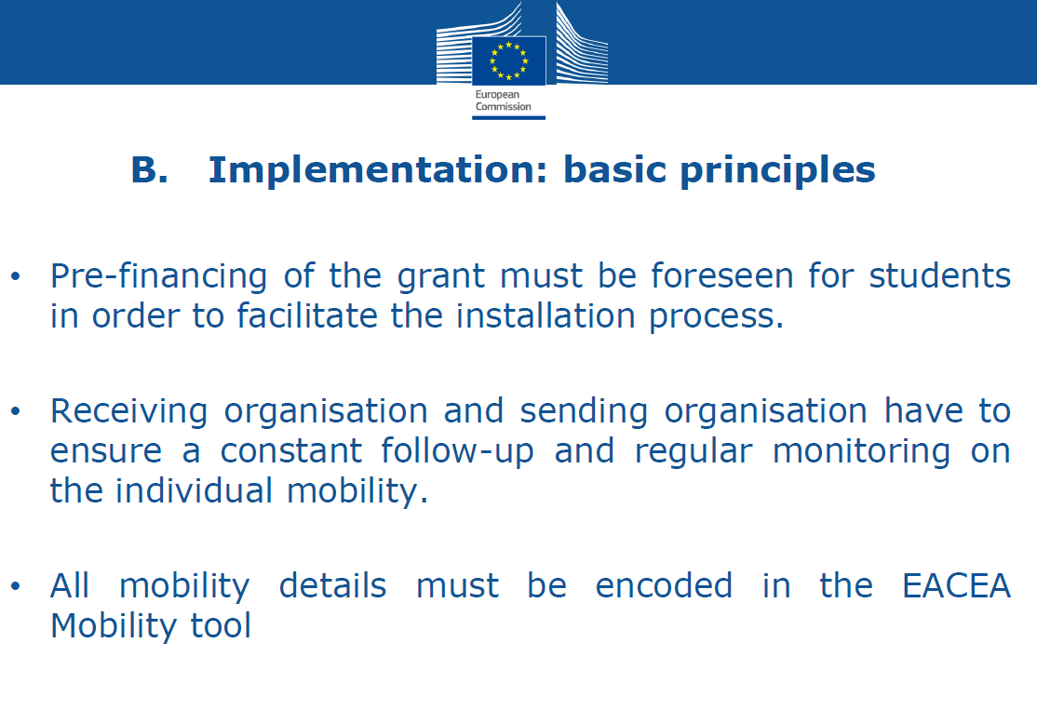
CHALENGES

Slide 33
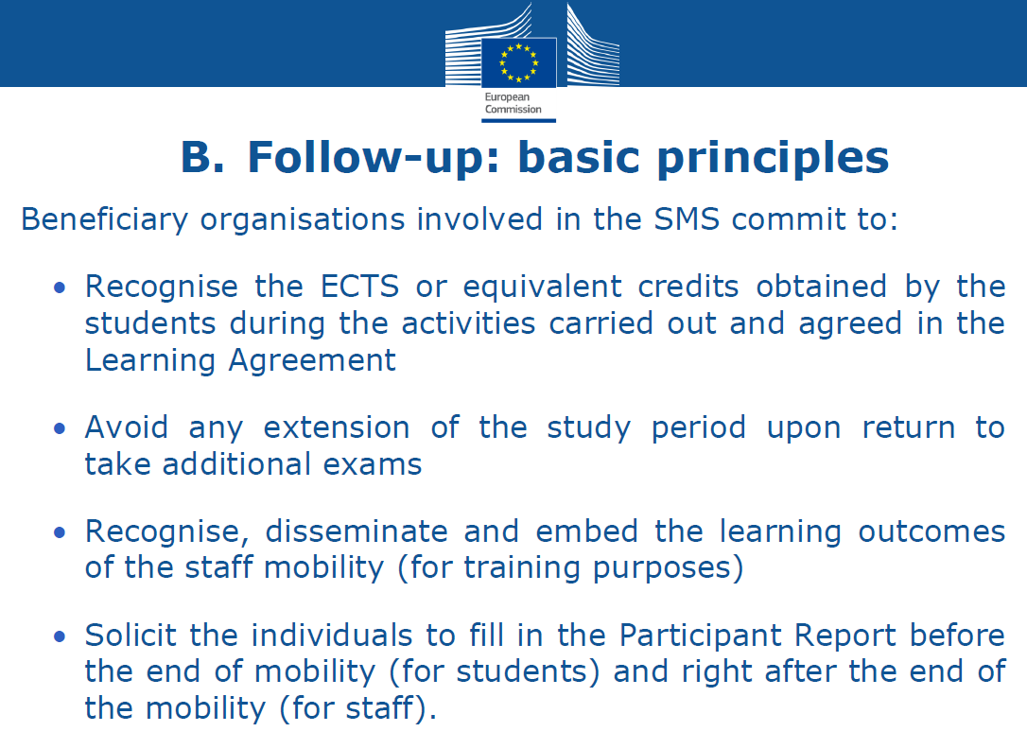
CHALENGES

Slide 34
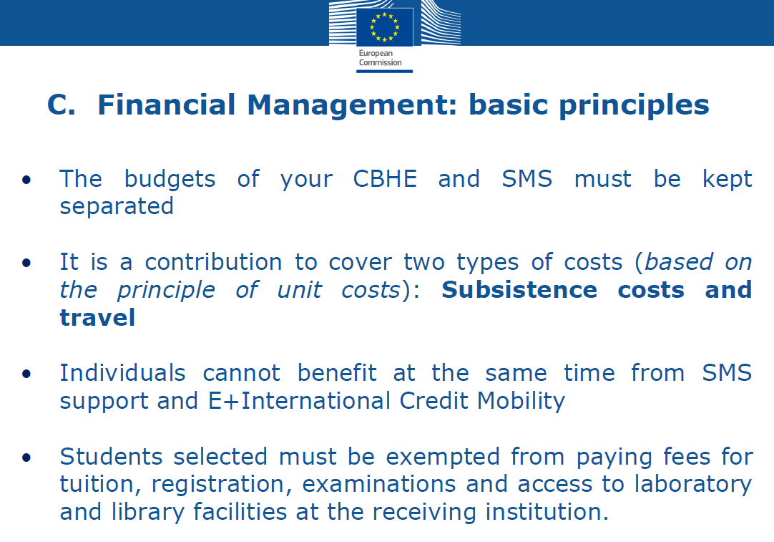
CHALENGES

Slide 35
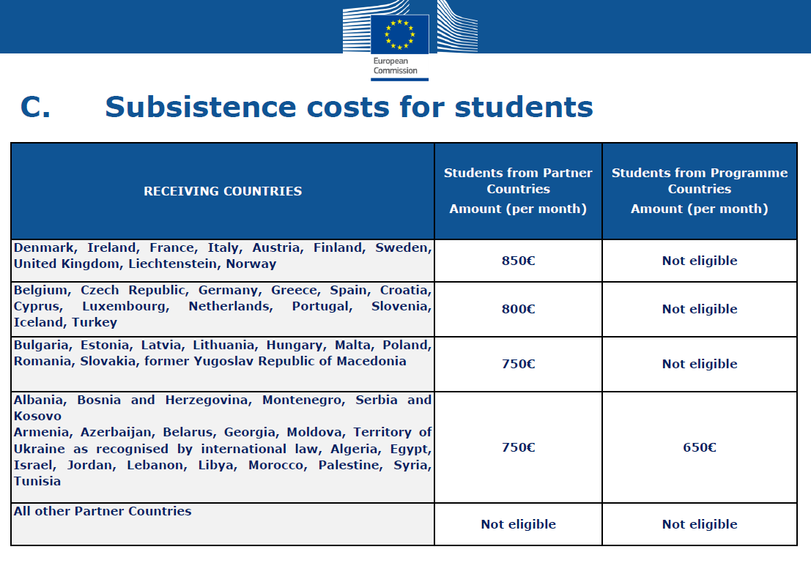
CHALENGES

Slide 36
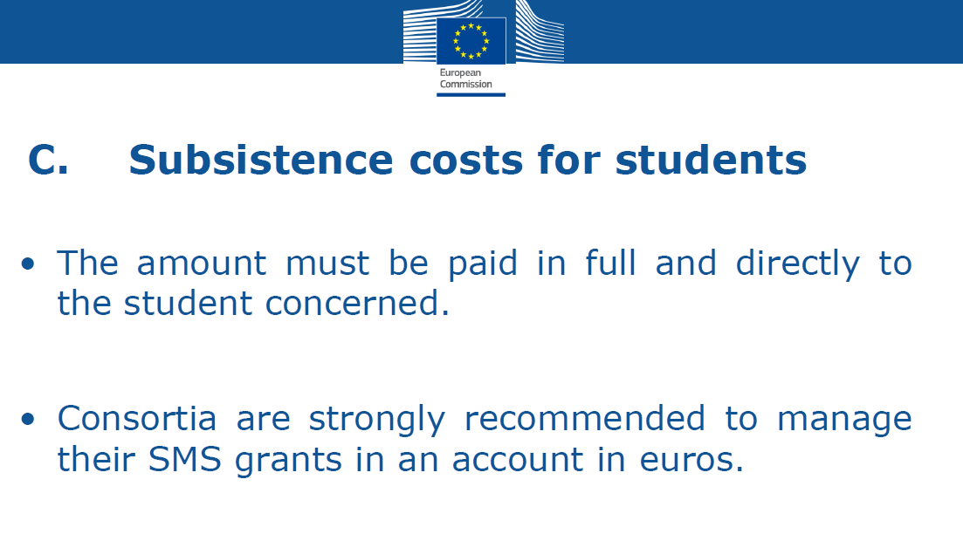
IMPOSSIBLE IN SERBIA

Slide 37
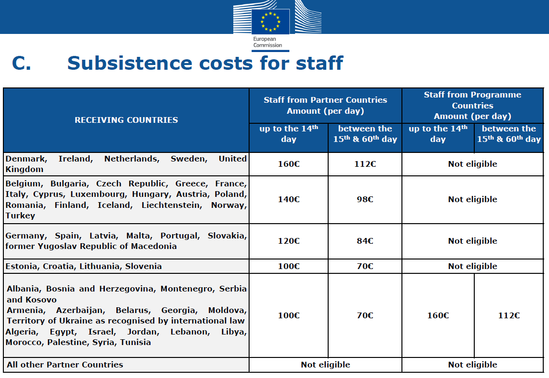

Slide 38
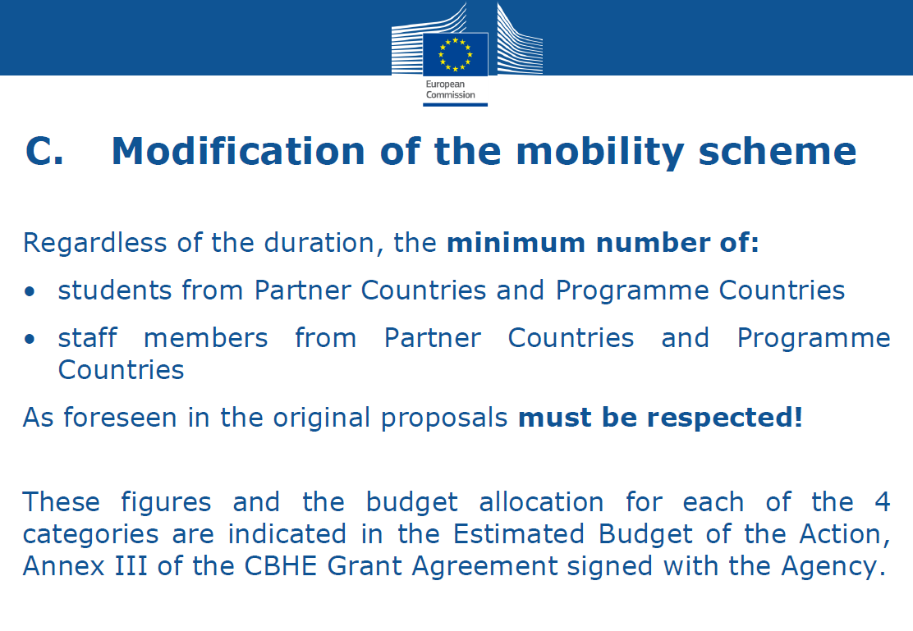

Slide 39
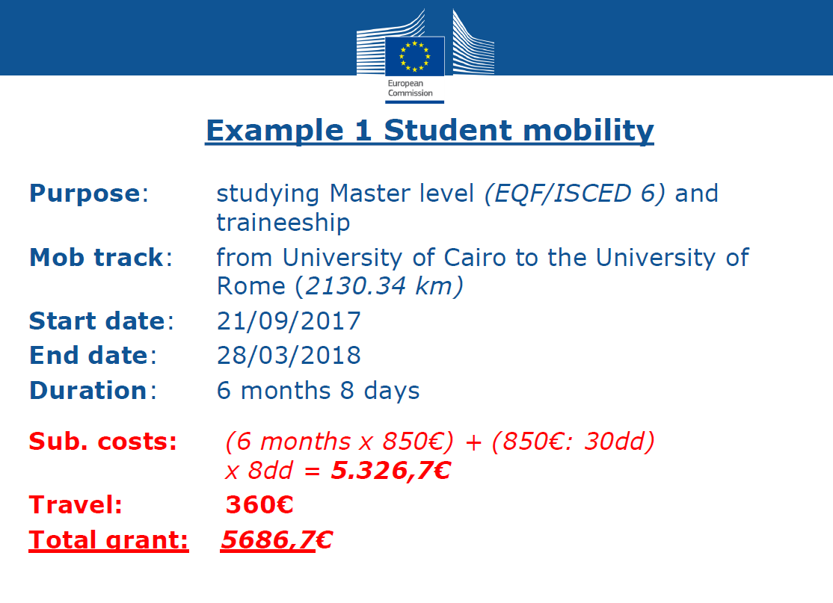

Slide 40
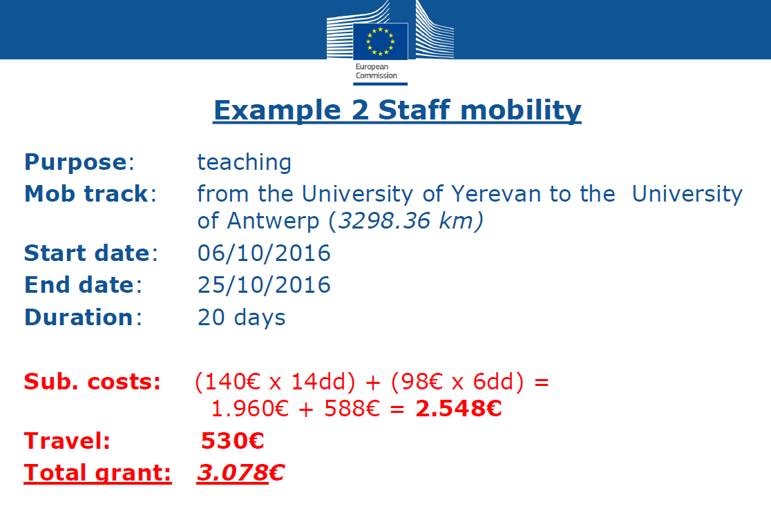

Slide 41
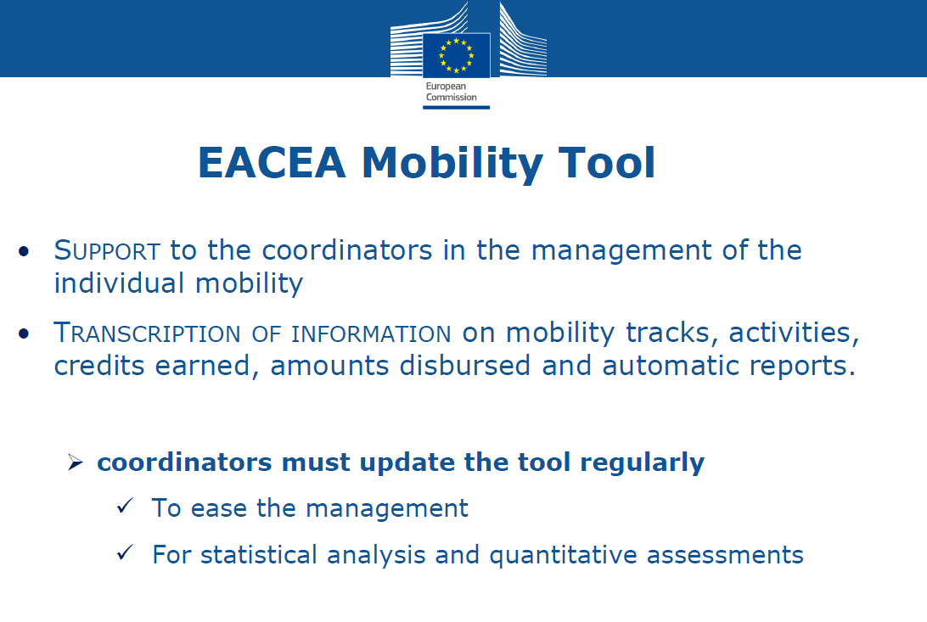

Slide 42

Knowledge FOr Resilient soCiEty
Thank you for your attention!
Write to us: k-force.pmt@uns.ac.rs
Follow us: http://kforce.uns.ac.rs/

